Slide 1
Chapter 1
The financial goals of a firm
Slides by Prof C Rootman, Dr S Watson, Ms E Kobese
& Ms N Maliwa

Slide 2
Learning outcomes: Chapter 1
describe the reasons for the existence of business firms
explain the need for a vision, mission and organisational culture of a firm
explain the role of the business model and strategy in managing a firm
evaluate the various forms of business organisation
distinguish between the long-term and short-term financial goals of a firm
relate the functions of a financial manager to the long- and short-term financial goals of a firm
describe the competencies of a chief financial officer (CFO)
apply the fundamental principles of financial management.

Slide 3
Introduction
Humans have needs and wants
Physiological, safety, social, esteem and self-actualisation needs
Firms satisfy these by providing products and/or services
Understand customers to best meet their needs
For firms: Could lead to…increase in sales, loyalty

Slide 4
Figure 1.1

Slide 5
Vision, mission and culture
Strategic planning sessions NB, firms concerned about LT futures (3Ps: possible, probable, preferable)
Aim to be sustainable, therefore need to re-imagine the use of scarce resources and protecting the environment, while improving people’s lives
Sustainability: ability of a firm to endure (LT) because it is environmentally bearable, socially equitable and economically (financially) viable
BUT there are forces…population growth rates, climate change, energy shortages, inflation, technology, etc.

Slide 6
Remember this key focus of this module
Business/corporate finance vs accounting vs financial planning
Keep a few things in mind
Finance is concerned with decisions about money/cash flows (CFs)
Everything else being equal: More value is preferred to less; the sooner cash is received the more value it has (because you can invest it, use it, etc.); less risky assets are more valuable than riskier assets
Make a choice: (1) R54 million today…or (2) R3.5 million each year for the next 30 years…? Concept of time value of money (TVM) will help you to make the right choice ☺ (all part of financial mngt.)

Slide 7
Vision, mission and culture (cont.)
Vision: What the firm should look like in the future (sets the direction for planning and strategy implementation)
Mission: Reason for a firm’s existence (reflect core business)
Org. culture: common set of behaviours, mindsets, beliefs in firm that determines engagement, productivity and success
Alignment with V and M, open communication, right employees recruited and retained, top mngt. = examples, rewards, prof. development

Slide 8
Business model and strategy
Business model: WHAT and HOW for the benefit (value) of CUSTOMER and BUSINESS
View it from 3 perspectives: marketing, operational, financial
Figure 1.2

Slide 9
Business model and strategy (cont.)
Financial view:
Cost structure vs Revenue and cash flows (CFs)
Firm should be profitable and maintain liquidity…
Profitability = revenue from sales > costs, expenses, interest and tax
Five main competitive forces
Figure 1.3
National economy: economic growth vs economic decline; when is it a recession?

Slide 10
Business model and strategy (cont.)
3 main strategies
Cost leadership
Differentiation
Focus
Manage growth of a firm, e.g. products have life cycles (PLC), similarly firms grow over time
Market penetration
Market expansion
Product expansion
Diversification
Take overs/acquisitions

Slide 11
Operating environment of firms
Not in isolation/in a vacuum, rather in a system
B2C vs B2B; Various stakeholders; Various depts internally
Legal constraints
Financial institutions and markets
Financial markets
Primary market: deals in new securities, e.g. shares, bonds issued for the first time
Secondary market: trades only existing securities, e.g. shares of companies listed on JSE
Money market vs Capital market
JSE functions

Slide 12
Ensuring sustainability – governance, internal control and risk management
Figure 1.7

Slide 13
Ensuring sustainability – governance, internal control and risk management (cont.)
Small firm: owner-manager will pursue the goal of wealth maximisation (we will come back to this as the MAIN financial goal of firms…)
Larger firms (e.g. public companies): ownership shared over a number of owners (e.g. shareholders)
Also want to maximise wealth, BUT…
Managers act not always in best interest of owners…conflict of interest: agency problem
How can this be managed?

Slide 14
Business strategies from a financial management perspective
One key to financial success (max. wealth) and sustainability = sufficient financing
Financing = Capital structure (will see later and in chapters to follow)
Owner’s hard-earned savings = equity
vs
Loans or borrowing fund = LT debt (must be repaid and with interest)

Slide 15
Forms of business organisations
Sole proprietorship
Partnership
Co-operative
Company
Private (Pty) Ltd. vs Public Ltd.
1 to 50 vs min. 7 shareholders
Min. 1 director vs Min 2 directors
Restricted transferability vs trade shares on JSE
Public company to publish annual financial statements
Taxed separate from owners @ 27%

Slide 16
Financial goal scenario
 | Sunny Side (my business) | Waterfall Ltd. (your business)
Profits for 2025 | R50 000 | R30 000 | Only looking at this…which business did best?
But to get the profit above… So, what was the return %? | Invested R200 000… 50 000/200 000 = 25% | Invested R110 000 30 000/110 000 = 27.27% | Only looking at this…which business did best?
Clearly, both profit maximisation and return maximisation are NOT the best (and NOT the main) financial goals!

Slide 17
Financial goals: LT goals
Medium to LT goal: increase & maximise wealth of owners (shareholders in case of Ltd. Company); therefore, maximise shareholders wealth (SHW)
This translates into increasing the value of the firm OR increase (current) share price (value)
HOW?
(1) Investing in assets
How funds/capital is used
Non-current (NC) or fixed or LT assets
[AND we will discuss current assets as well]

Slide 18
Financial goals: LT goals (cont.)
HOW?
(2) Keeping cost of capital low
How funds/capital is raised/sourced…2 options
(a) Debt (funds raised through borrowing; BUT again compensation/return needed: pay back and pay interest
(b) Equity (funds raised from owners/shareholders that purchased shares); BUT they need to be compensated/require a return…again 2 ways: increase in sh. price/value as a capital gain over time and/or dividends

Slide 19
Financial goals: LT goals (cont.)
These will both (1) and (2) be discussed in several chapters to follow; as 2 of the 3 main financial decision-making areas…
LT investing in assets /using or spending capital = capital budgeting decisions (e.g. assets for expansion)
Cost of capital/LT raising or sourcing capital through debt and/or equity = capital structuring decisions (e.g. bonds/loans and/or sell shares)
AND 3rd decision-making area
Working capital decisions (operational: current assets vs current liabilities)

Slide 20
Financial goals: ST goals
Profitability
Generate revenues through sales in excess of total costs
Liquidity
Ability to satisfy ST obligations as due
E.g. accelerate CFs from accounts receivable (AR)/debtors; delay CFs to accounts payable (AP)/creditors; don’t over-invest in inventory (note there are also under-investment implications)
Solvency
Extent assets > liabilities; Total assets (TA) vs Total liabilities
[Note: TA = Total capital (TC)]

Slide 21
Financial goals: MAIN goal
Why is maximising SHW the main goal? Why is SHW maximisation preferred to profit maximisation?
Shareholders expect to receive a return: dividends or increases in value of shares; value of shares reflected in current/market price of share (@ any time, therefore this should be the goal)
Profit max. is a ST approach
Prof max. does not take risk into account; FM premise: trade-off between risk and return in that expect to receive higher returns from higher risk investments as compensation for undertaking the risk (and vice versa)
Only Rand vs Rand for a period; ignore when (timing) and what was invested to gain this profit

Slide 22
Functions of a CFO
Making investment decisions (capital budgeting)
Making financing decisions (capital structuring)
While ensuring profitability, positive CF, solvency
Thus, also making working capital decisions
Competencies required of CFO of Ltd. Company
Knowledge, skills, values, attitude, attributes/experience

Slide 23
Fundamental principles of FM
Cost-benefit
Risk-return
Higher risk, higher required rate of return
Time value of money (TVM)
Could increase value of an amount by earning interest; longer, then interest on interest or compounding;
Invokes concept of opportunity cost
Business rescue

Slide 24
Capital budgeting example
A major European carmaker spent R3 billion on a factory in SA
Source: Adapted from Taylor, M. 2024. https://topauto.co.za/features/115912/why-a-major-european-carmaker-spent-r3-billion-on-a-factory-in-south-africa/ (22 September)

Slide 25
Capital budgeting example (cont.)
A major European carmaker spent R3 billion on a factory in SA
Source: Adapted from Taylor, M. 2024. https://topauto.co.za/features/115912/why-a-major-european-carmaker-spent-r3-billion-on-a-factory-in-south-africa/ (22 September)

Slide 26
Capital structuring examples
Source: https://www.nasdaq.com/articles/pan-african-resources-issue-new-ordinary-shares (9 December 2024)
Sources: Siwele, K. 2024. https://www.biznews.com/sa-investing/2024/11/28/boxer-retail-soars-largest-ipo-2017#:~:text=Boxer%20Retail%20Ltd.%20made%20a%20strong%20debut%20on,potential%20to%20reach%208.5%20billion%20through%20additional%20shares (November)

Slide 27

MAIN financial goal explanation
Maximise SHW = maximise firm’s value = maximise current/market price of a company’s shares
Current value of a house you consider buying?
To calculate SHW, calculate the change in share price over a period
% change in share price = [(New price – Old price) / Old] x 100
Value (of any investment) based on CFs (projected); CFs sooner (timing); Riskiness (risk of projected CFs/earnings)
Or understand it this way:
Value = worth of the expected future CFs restated in current rands
Value = present value (PV) (or current or net) value of the future CFs
$$P_{0} = \sum_{t = 0}^{t}{\frac{1}{{\left(1 + ks\right)}^{t}}}$$

Slide 28
Example of share price changes
Example of share price changes…due to various factors
Sources: Adapted from Mackenzie, J. 2025.
https://www.businesslive.co.za/bd/companies/retail-and-consumer/2025-01-27-lewis-sales-jump-almost-10-as-consumer-confidence-improves/ (27 January); www.sharedata.co.za

Slide 29
Example of share price changes (cont.)
Example of share price changes…due to various factors
Sources: Adapted from Mackenzie, J. 2025.
https://www.businesslive.co.za/bd/companies/retail-and-consumer/2025-01-27-lewis-sales-jump-almost-10-as-consumer-confidence-improves/ (27 January) ; www.sharedata.co.za

Slide 30
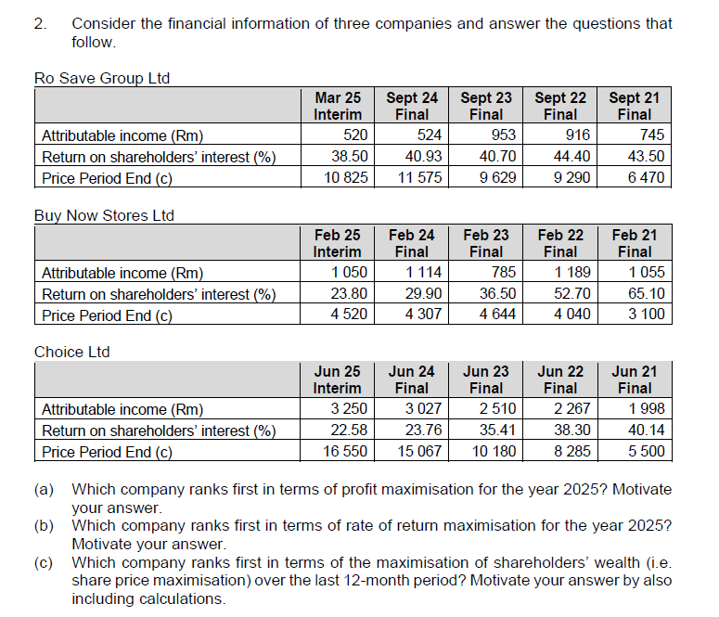
Example – SG pg. 14

Slide 31
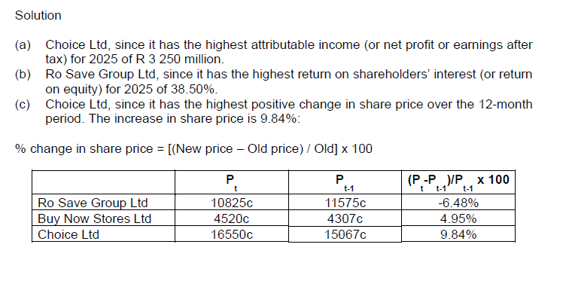
Example (cont.) – SG pg. 14

Slide 32
Preparation for next session
Work through Chapter 1
Questions in study guide
Problems at the end of the chapter
Read through Chapter 3 and download/print the slides

